Slide 1
Contribution History Log
Slide | Contributor | Date
7-8, 11 | Matthew | 11/9/2017
13 | Brandon | 11/9/2017
3-4 | Joseph | 11/9/2017
9 | Erik | 11/9/2017
5-6 | Kyle | 11/9/2017
10, 14-15 | Evan | 11/9/2017

Slide 2

Brandon Jackson, Erik Culberson, Evan Bradley, Kyle Schrade,
Joseph Herkness, Matthew DeMott

Slide 3

User Story 20
As a Shopper, I can go back to a previous product in the channel so I can change my input on it.
Functional Requirements
66
Nonfunctional Requirements
19

Slide 4
User Story 21
As a Shopper, I can search for a new channel so I can subscribe to channels.
Functional Requirements
63
Nonfunctional Requirements
17

Slide 5
User Story 22
As a Shopper, I can view more information on a product so I can see if I want to buy the product.
Functional Requirements
64, 65
Nonfunctional Requirements
18

Slide 6
User Story 23
As a Shopper, I can search for other Shoppers to follow so I can see what products they like.
Functional Requirements
66
Nonfunctional Requirements
17

Slide 7
User Story 24
As a Shopper, I can review the channels I have subscribed to so I can see the categories of products I have subscribed to.
Functional Requirements
70, 71
Nonfunctional Requirements
21

Slide 8
User Story 25
As a Shopper, I can review the Shoppers I have followed so I can managed the Shoppers I can see.
Functional Requirements
68, 69
Nonfunctional Requirements
20

Slide 9
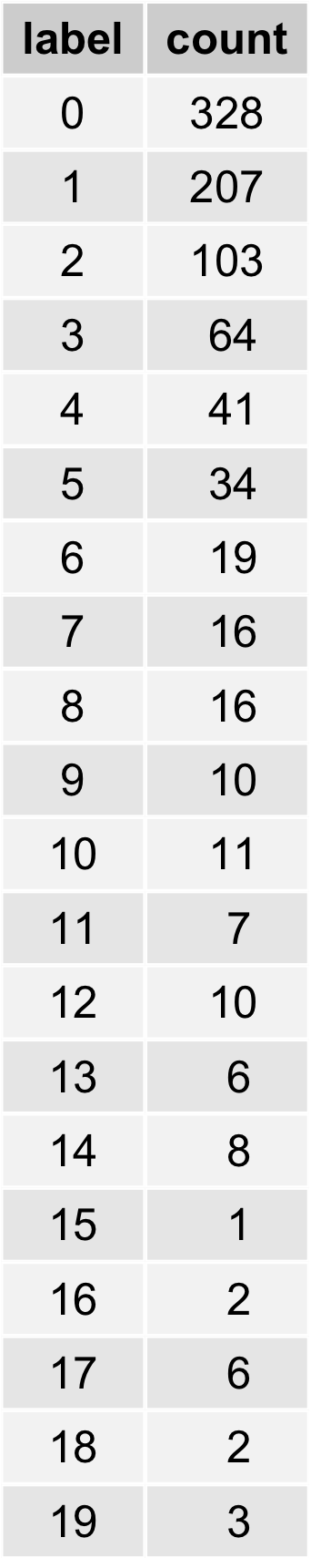
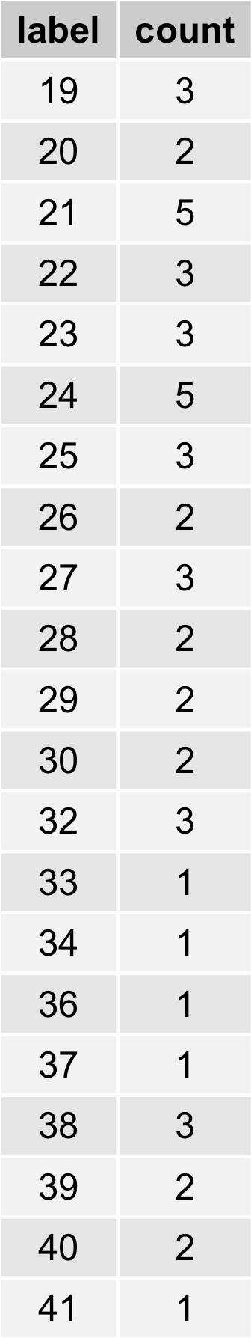
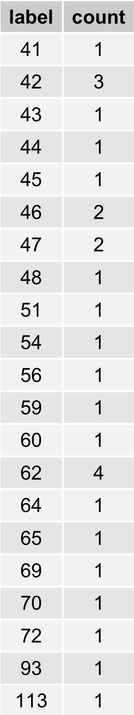
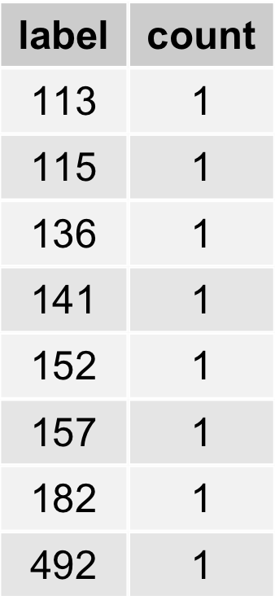
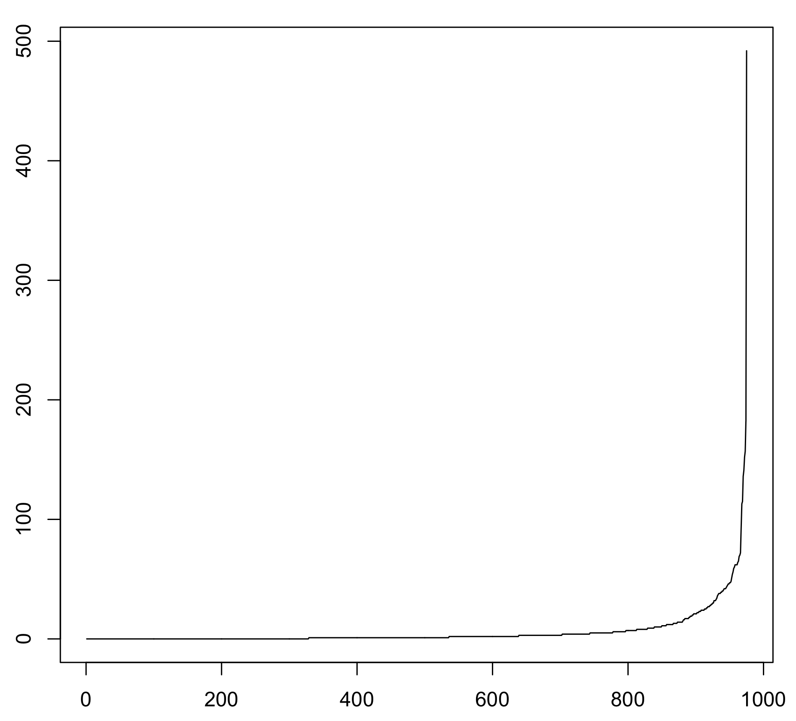
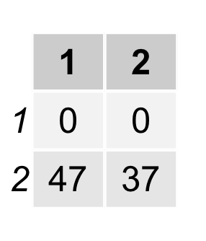
Suggestion Algorithm - Naive Bayes

Slide 10
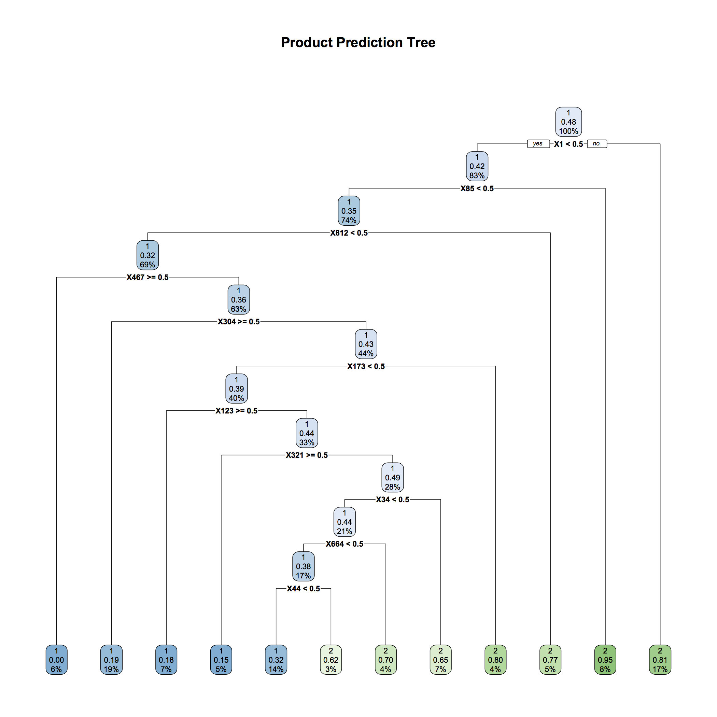
Suggestion Algorithm – Decision Tree
 | Actual Like | Actual Dislike
Predicted Like | 31 | 14
Predicted Dislike | 16 | 23

Slide 11
Sprint 6 Objectives
Stage 3 Of Suggestion Algorithm
Search Liked Products
Mobile Friendly Website
Finalize Documentation
Final Presentation Poster
General Channel
Improving Front End Design

Slide 12


Slide 13
Machine Learning

Slide 14
Demo

Slide 15
Questions

